Slide 1

MCOSS2WED
Bootstrap Forms

Slide 2
Bootstrap forms
Bootstrap offers a large range of pre-styled form controls
They look good
They can be customised
They are flexible

Slide 3
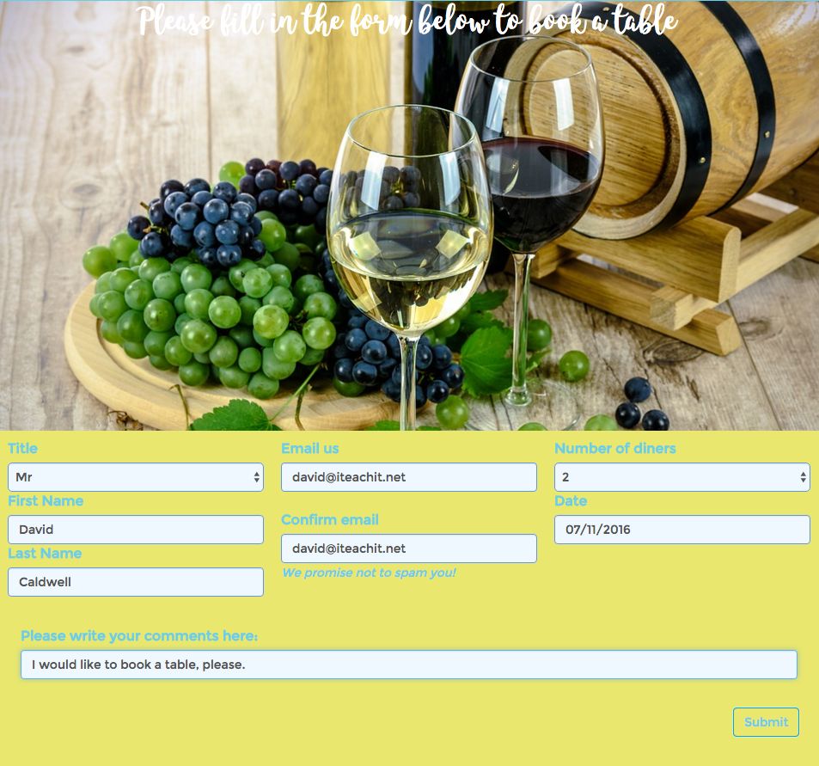
Example

Slide 4
Building a form
Start with a blank HTML template
Copy the Bootstrap CDN links into it
Or just download the Bootstrap Page Template from http://www.iteachit.net/reference

Slide 5
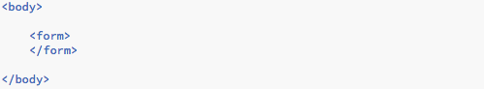
Building a form
We are going to start with a form tag

Slide 6
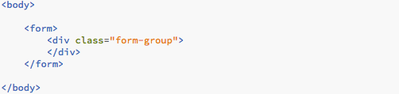
Building a form
Now, add a div with the class ‘form-group’
We can customise the styling if we need to later

Slide 7
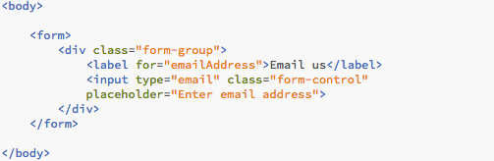
Building a form
We will begin building our form by adding an email address input box

Slide 8

Building a form
It should look something like this
It reaches across the entire page. This width can be taken care of later

Slide 9
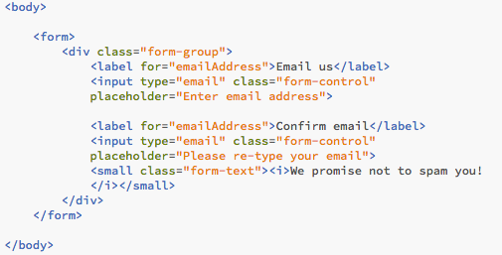
Building a form
Add a second confirmation email address text box

Slide 10
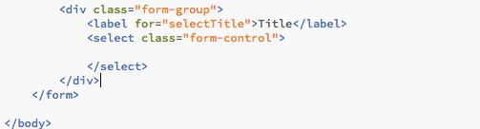
Building a form
Next, we want to add a title selector (Mr, Mrs, etc)
To do this, we are going to use a select control
Add another form-group div after your second email input box
Add a label and select form control

Slide 11
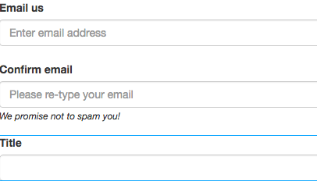
Building a form
So far, your form should look like this

Slide 12
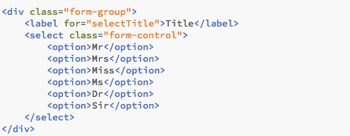
Building a form
We need to add options to choose from in our selector form control

Slide 13

Building a form
Let’s add input boxes for first and last names
The format for this is similar to the email input boxes

Slide 14
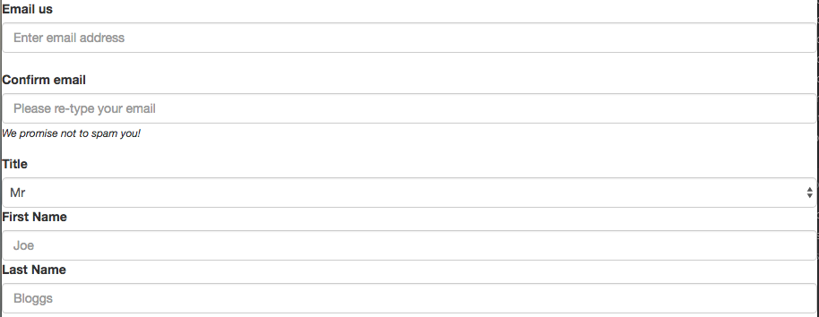
Building a form
The form looks like this so far

Slide 15
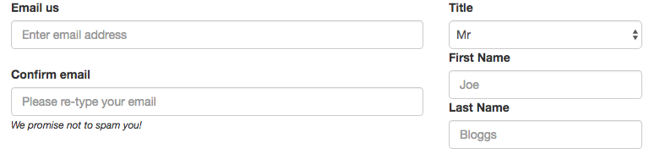
Building a form
We can improve the layout a little by adding responsive column classes to the form groups

Slide 16


Building a form
Add col-sm-8 to the first form group
Add col-sm-4 to the second form group

Slide 17

Building a form
To customise the styling, add a style sheet to you HTML page at the end of the <head> section
Create a CSS file and add a form-group section

Slide 18


Building a form
Add some styling to the form-group section
Add a form-control section to your CSS file and style that too
See example forms-example10.html & .css

Slide 19

Building a form
Bootstrap offers a range of pre-styled button classes
Try these classes: btn-primary, btn-success, btn-info, btn-warning, btn-danger
See example forms-example11.html & .css

Slide 20
Building a form
Choose a button style and add a submit button to the bottom of your form
Remember, you can customise the style later
See example forms-example11.html & .css

Slide 21
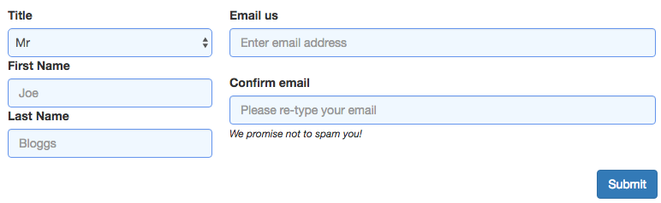
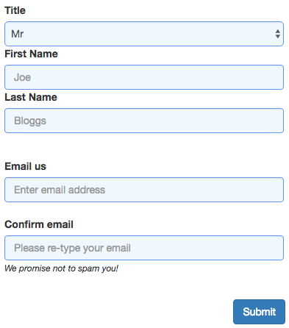
Building a form
Have a play with the form styling and layout until you get something you like
Don’t forget to check that it it still responsive
See example forms-example12.html & .css

Slide 22
Building a form
Your form should be transportable if you copy and paste the <form> section into another page (provided you remember to copy any CSS needed as well)
See example bookable.html & .css

